Slide 1
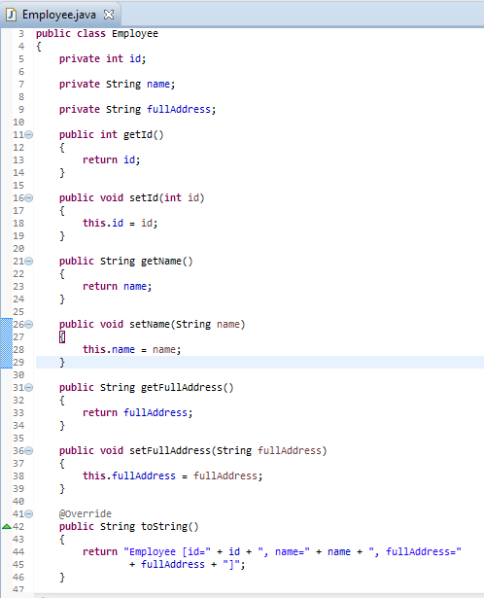
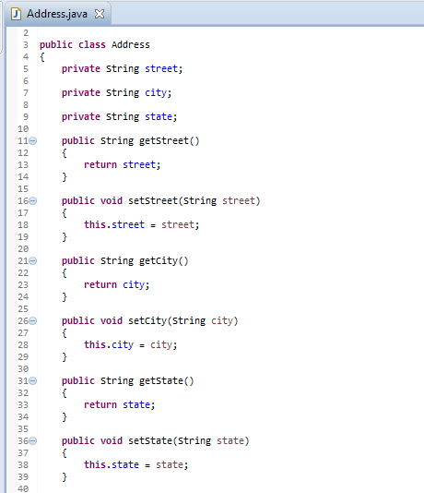
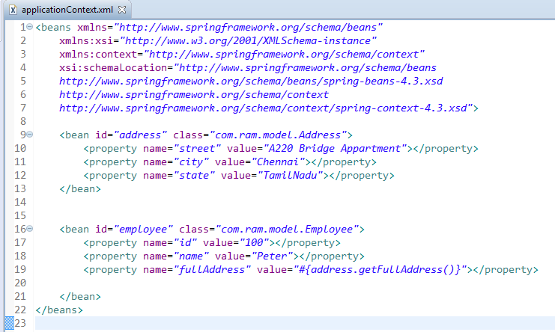
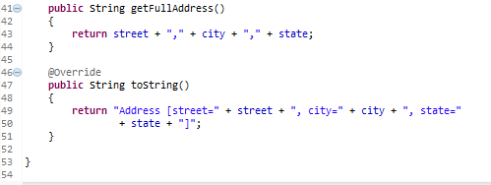
Spring EL method invocation - XML
Spring expression language (SpEL) allow developer uses expression to execute method and inject the method returned value into property, or so called “SpEL method invocation“.

Slide 2
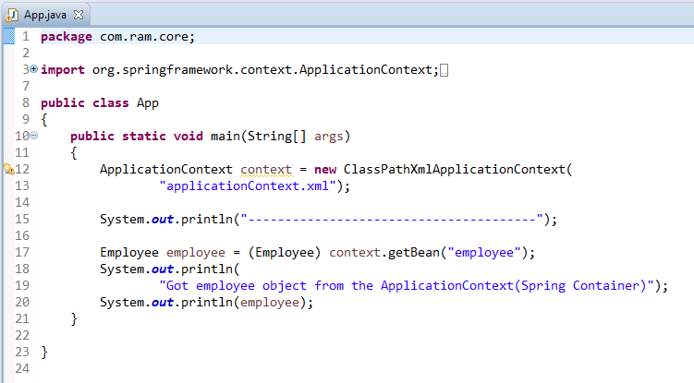

Spring EL method invocation - XML

